Slide 1
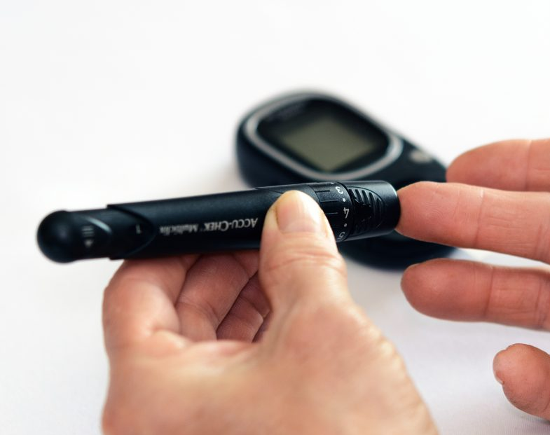
Dermal Tattoo Biosensors for Colorimetric Metabolite Detection

Slide 2
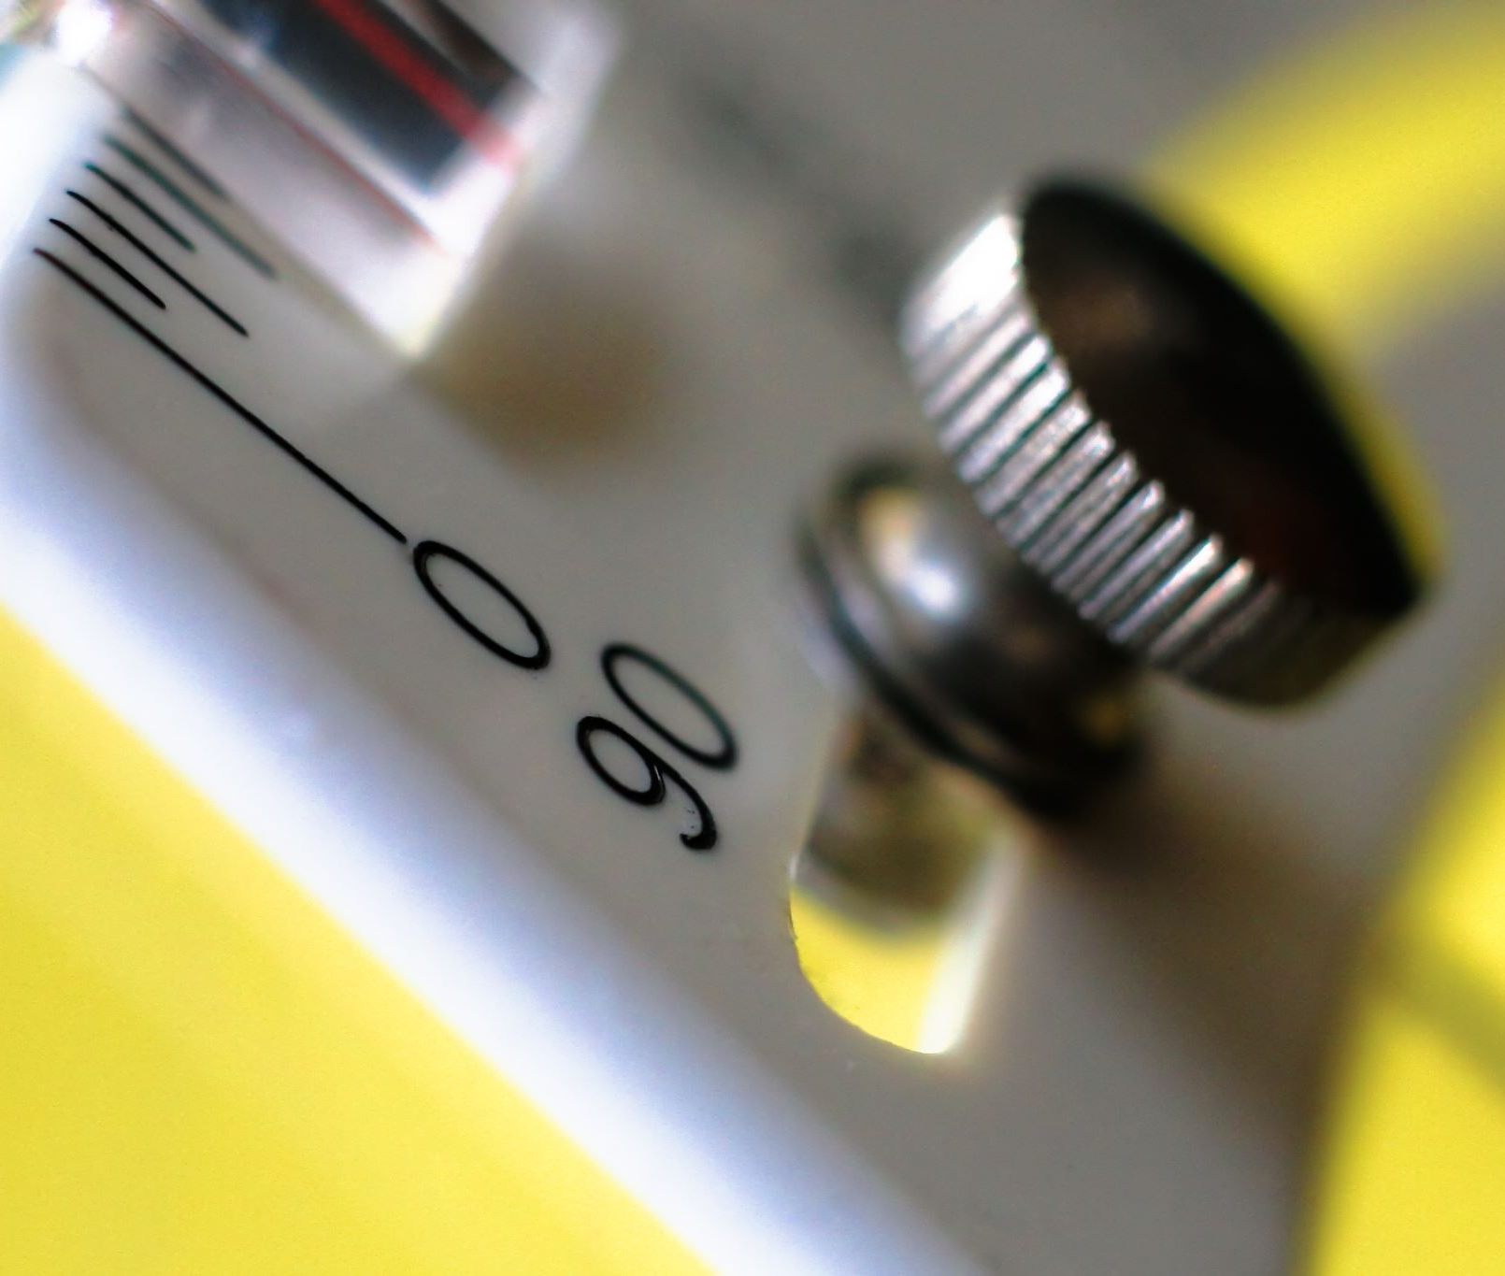
What is a tattoo biosensor
In general, a tattoo biosensors are a type of wearable technology that can be applied to the skin.
They are made from a flexible material that can stretch and move with the skin.
Dermal tattoo is a body art modiﬁcation by injecting pigments into skin dermal layer.
The replacement of traditional tattoo inks with colorimetric sensing reagents can contribute to a quantitative sensing platform to detect health-related biomarkers in skin.

Slide 3
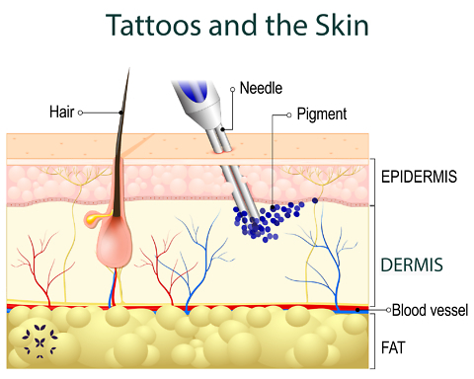
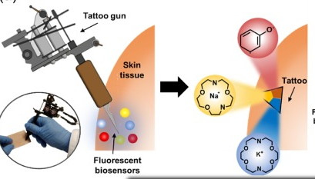
How do we inject the tattoo biosensor on the skin?!
https://kaleidoscopefightinglupus.org/lupus-and-tattoos/
https://www.sciencedirect.com/science/article/abs/pii/S0925400520307231

Slide 4
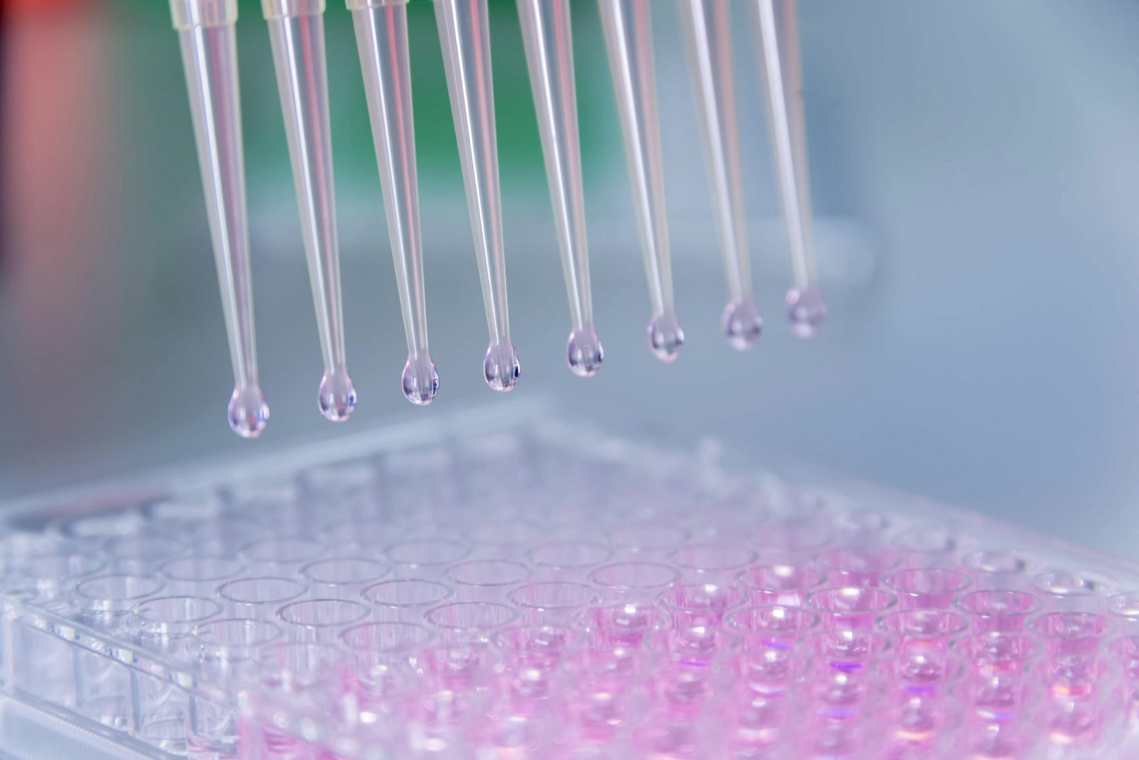
why do we need a tattoo biosensor instead of normal sensors?
Continuous monitoring
non-invasively
Conveniently
The Ease of use
Cost-effectiveness

Slide 5
The enhancement in this type of sensors
We already have a non-invasive electrochemical skin-worn patches which are used to measure the health Biomark's through the sweat however this type has some drawbacks which this type can deal with such as:
the mismatch between sweat and blood compositions
time lag in indirect measurements
electrochemical signal drift
The need for frequent calibration

Slide 6
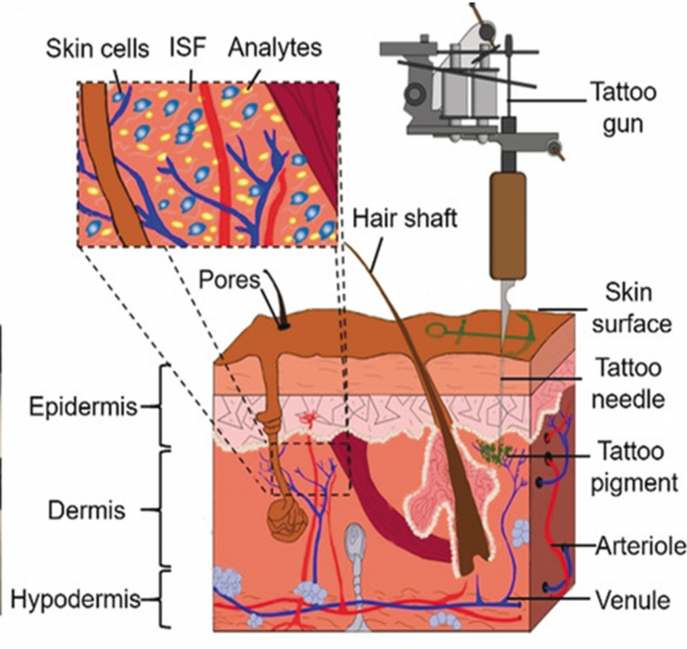
Working methods:
a functional cosmetic technology was developed by combining tattoo artistry and colorimetric biosensors
The inks were injected using a normal tattoo gun into the dermis of the skin tissues to create visible assay area
Figure 1. Injection of colorimetric biosensors within the dermis.

Slide 7
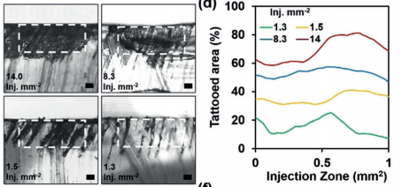
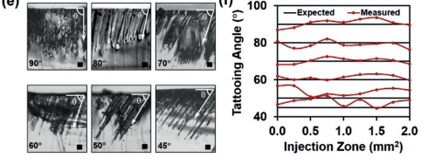
The amount of area being covered by the bio-ink is determined by the angle of the needle and how many injection being applied for each mm²
Figure 1 : Tattooed area over the total cross-section area with 14.0, 8.3, 1.5,
and 1.3 injections /mm2
Figure 1
Figure 2: tattooed at angles of
90º,80º,70º,60º,50º, and 45º between the needle of the tattoo gun and the skin surface.
Figure 2

Slide 8
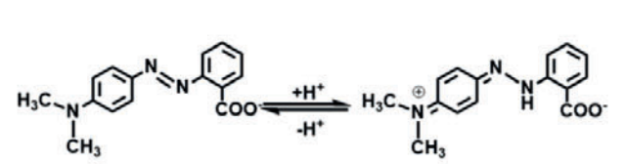
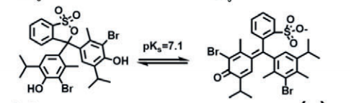
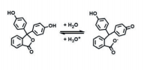
Dermal biosensors consisted of chromogenic dyes for the
colorimetric detection of pH and glucose
1. pH sensing element:
The normal pH range in interstitial fluid (ISF)is from 7.35 to 7.45
The dermal pH sensor was based on methyl red(a), bromothymol
blue(b), and phenolphthalein(c)
These materials respond to changes in the pH and change its colors
(a)
Methyl red changes from red (pH4.3) to Yellow( pH6.2)
Bromothymol changes from yellow ( pH 6.0) to blue (pH7.6)
Phenolphthalein changes from pink (pH 8.2) to fuchsia (pH 12.0)
(b)
(c)

Slide 9
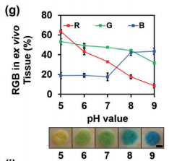
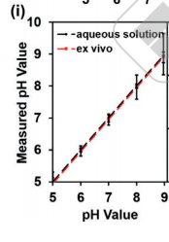
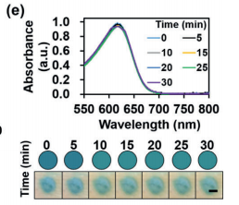
The net result is a color change from yellow to blue (pH values from 5.0 to 9.0) (1)
(1)
no change in the absorbance of pH after applying 2W UV light for 30 minutes (2)
The measurements obtained from the biosensors are same compared to the actual pH values measured by an ion-selective electrode (3)
(2)
(3)

Slide 10
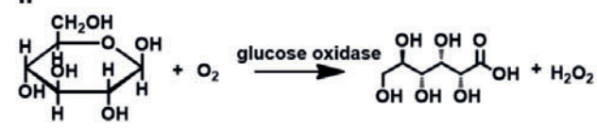
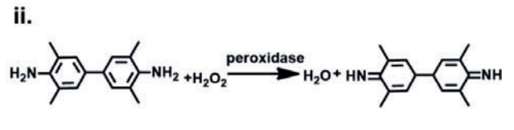
2. glucose sensing element:
The mean glucose concentration in the blood of a fasting person ranges from 4.2 to 6.4 mmol/L
Glucose concentrations higher than 7.0 mmol/L maybe an indication of diabetes
glucose is oxidized to d-gluconolactone and hydrogen peroxide is produced.
Chemical structures of the glucose-sensing compounds :
glucose oxidase (GOD)
peroxidase (POD)
tetramethylbenzidine (TMB)
Under peroxidase catalysis, hydrogen peroxide oxidizes TMB to form a blue–green dye

Slide 11
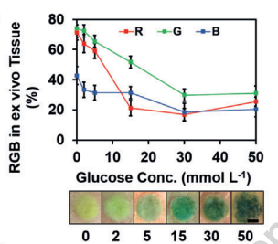
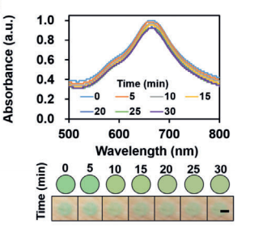
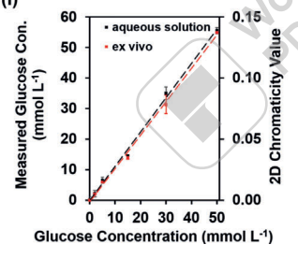
The net result is a color changes is shown in (1)
no change in the absorbance of glucose measurements after applying 2W UV light for 30 minutes (2)
(1)
The measurements obtained from the biosensors are same compared to the actual glucose values readouts by a glucose sensors (3)
(2)
(3)

Slide 12
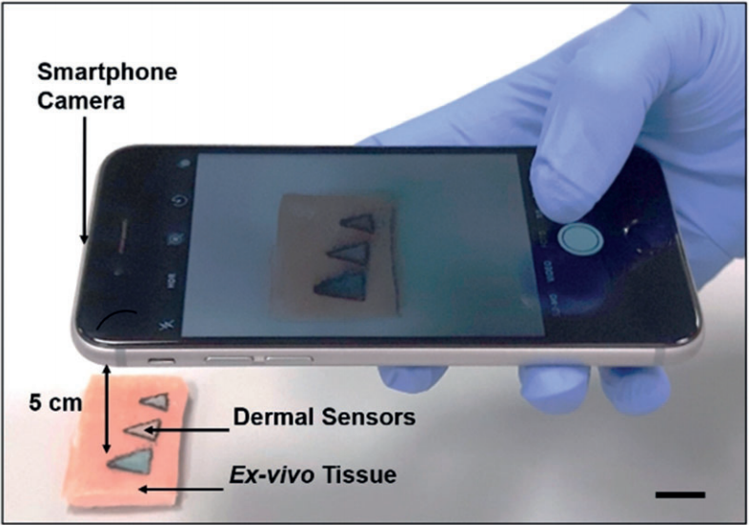
The outcome of this model
Upon the testing procedure a system of three tattoos were applied on a porcine skin to provide quantitative imaging of pH, glucose, and albumin assays using a smartphone camera.
The color of the tattoos indicates the levels of each substance, by analyzing this color we can define the condition of the patient.
The assay is imaged using a smartphone camera at a distance of 5 mm normal incidence (perpendicular) to the detection area.

Slide 13
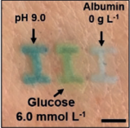
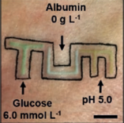
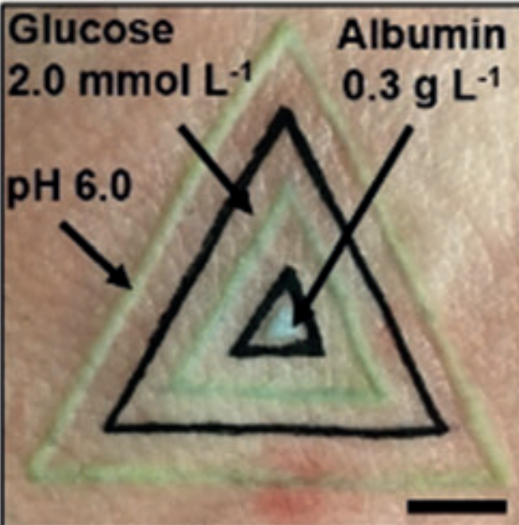
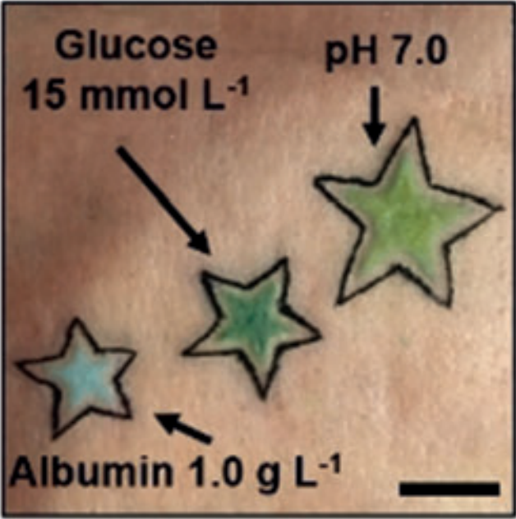
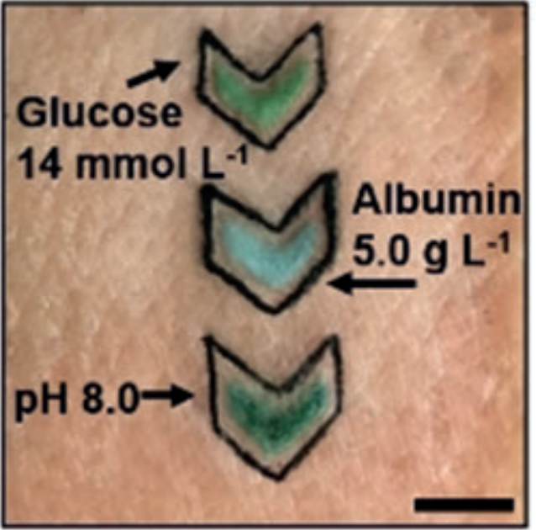
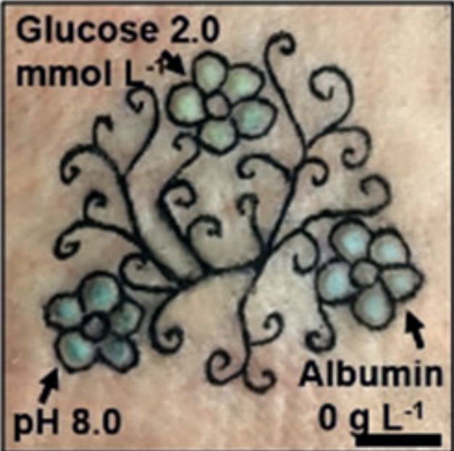
some examples:
alkalosis
metabolic acidosis
Hyperglycemia
co-developed hypoglycemia and respiratory alkalosis
Hypoglycemia
hypoalbuminemia

Slide 14
Conclusions
We have presented a colorimetric dermal tattoo biosensor for the detection of multiple health-related biomarkers without complex operations.
The developed colorimetric dermal tattoo biosensor would beneﬁt the ﬁeld of health management and disease monitoring, especially for chronic patients, because of its aesthetic and minimally invasive properties, suitability for multiple environmental conditions
the sensor feasibility should be assessed in vivo animal models to assess immunogenicity and foreign body response.
The applications of the sensors can be extended to the detection of electrolytes, proteins, pathogenic microorganisms, gasses and dehydration status.
The developed dermal sensors may have an application in medical diagnostics to monitor a broad range of metabolite biomarkers.

Slide 15
References
Yetisen, A. K., Moreddu, R., Seifi, S., Jiang, N., Vega, K., Dong, X., Dong, J., Butt, H., Jakobi, M., Elsner, M., & Koch, A. W. (2019). Dermal Tattoo Biosensors for Colorimetric Metabolite Detection. Angewandte Chemie International Edition, 58(31), 10506–10513. https://doi.org/10.1002/anie.201904416
He, R., Liu, H., Fang, T., Niu, Y., Zhang, H., Han, F., Gao, B., Li, F., & Xu, F. (2021). A Colorimetric Dermal Tattoo Biosensor Fabricated by Microneedle Patch for Multiplexed Detection of Health‐Related Biomarkers. Advanced Science, 8(24), 2103030. https://doi.org/10.1002/advs.202103030
Jiang, N., Yetisen, A. K., Linhart, N., Flisikowski, K., Dong, J., Dong, X., Butt, H., Jakobi, M., Schnieke, A., & Koch, A. W. (2020). Fluorescent dermal tattoo biosensors for electrolyte analysis. Sensors and Actuators B: Chemical, 320, 128378. https://doi.org/10.1016/j.snb.2020.128378

